Slide 1
Chapter 10 Image Segmentation

Slide 2
10.1 Fundamentals
What is Image Segmentation?
Background / Foreground

Slide 3
10.1 Fundamentals
R: entire Image
Partitions R into n sub regions R1,R2,Rn
U Ri = R
Ri is Connected set
Ri ∩ Rj = ф (empyti)
Q(Ri) = True for i=1,2,…,n
Q(Ri U Rj)=false, for any adjacent regions Ri,Rj

Slide 4
10.2 Point, Line and Edge Detection
10.2.1 Background

Slide 5
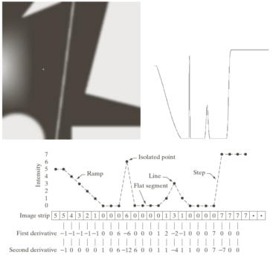
10.2.1 Background

Slide 6
10.2.2 Detection of Isolated Point

Slide 7
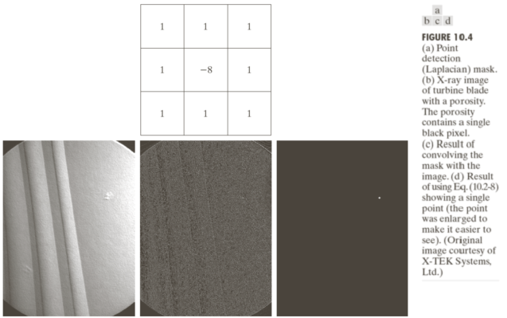

Slide 8
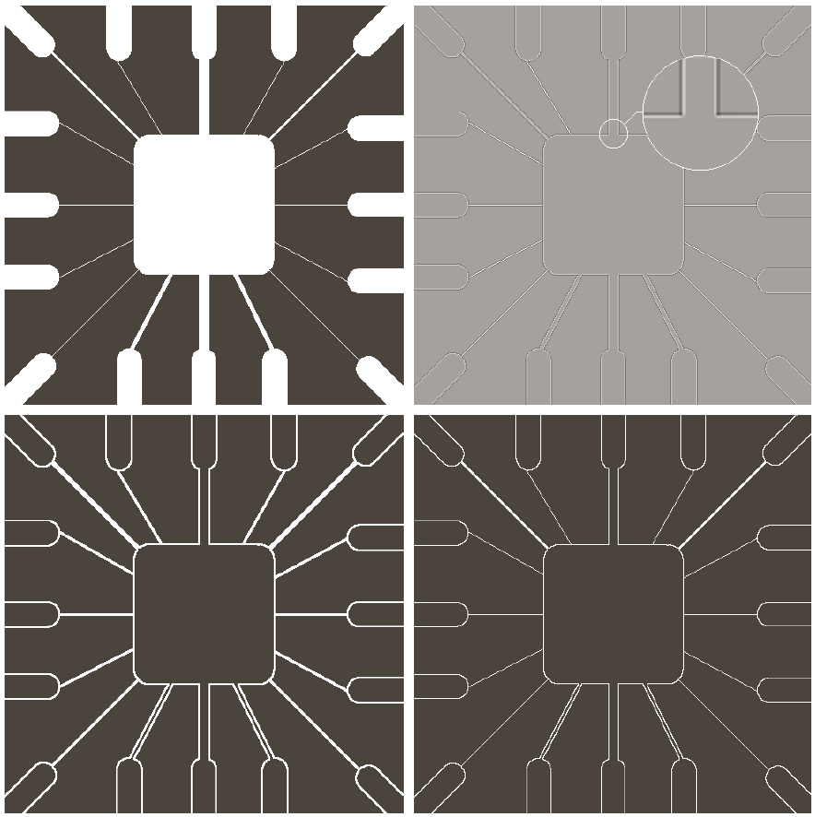
10.2.3 Line Detection(10.21)

Slide 9
10.2.3 Line Detection
Line Detection Mask

Slide 10

10.2.4 Edge Models
Step, ramp and roof edge

Slide 11
10.2.4 Edge Models

Slide 12
10.2.4 Edge Models

Slide 13
10.2.5 Basic Edge Detection
The image gradient and its properties
Gradient

Slide 14
The image gradient and its properties
Magnitude (length) of gradient vector
Direction of gradient vector

Slide 15
The image gradient and its properties

Slide 16
Gradient operators

Slide 17
Gradient operators

Slide 19
Combining the gradient with thresholding

Slide 20
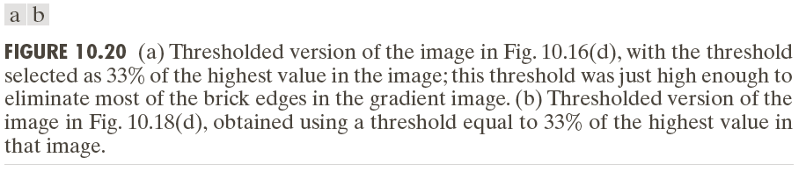
Combining the gradient with thresholding

